Slide 1
Stepping up or stepping out?
Volunteer leaders in Australian Grassroots Associations
Dr Christel L. Mex
Research Associate

Slide 2

G’Day!
Notes:
Thank you for your kind introduction.
Today I will be sharing my research with you, into the leaders of grassroots associations in Australia.
It is part of a doctoral thesis which is attached to an Australian Research Council project entitled Creating and Sustaining a Strong Future for Volunteering in Australia, exploring the neglected topic of why people don’t volunteer.
The project is a partnership between the peak bodies of volunteering in Australia, and five universities including Curtin (who is home to the project’s Chief Investigator, Professor Kirsten Holmes), Macquarie, the William Angliss Institute and Erasmus University in Rotterdam.
In today's presentation, I will
Present research findings from six focus groups and an online survey
Share my conclusions, and
Identify further opportunities for research.

Slide 3

Volunteering declining in Australia
Almost 70% are not volunteering
Median hours declining
People more discerning
New associations in decline
Australian Bureau of Statistics (2015)
Harrison Research (2016)
SA Office of Consumer and Business Affairs (2017)
Notes:
According to the Australian Bureau of Statistics, volunteering is declining in Australia, and it’s down from a high of 36% in 2010, to 31% today.
And those who are volunteering, are spending less time doing it - from an average of 2.5 hours per week in 2010, to 2 hours per week today.
Fewer new associations are being registered, at least in South Australia where I live. In 2016, only 315 new associations were formed, compared to a high of 709 in 1985, and we have seen a steady decline of new registrations since then.
In addition, people are now, more than ever, very discerning about how they spend their time. It’s a busy, busy, world out there and its very telling that the most common response to the ‘how are you’ greeting in Australia, is, “Oh, I’m so very busy!”.
However, at the same time, society in Australia is becoming more and more dependent on volunteers.
We rely on them to run our grassroots sporting associations such as the local football club, service clubs such as Zonta, environment conservation groups and many aged care services such as Meals on Wheels.

Slide 4
Grassroots associations are the neglected majority
67% of all not-for-profit organisations
Estimated number 440,000
About 3% of Australia’s GDP
Australian Productivity Commission (2010)
Notes:
Grassroots associations are a neglected, but important topic for researches.
Most research of the third sector concentrates on large charities and not-for-profit associations, who employ paid staff and have formal reporting requirements.
However, when examining the statistics in the Australian Productivity Commission’s report into Australian Charities, it appears that 67% of all not-for-profit organisations have no staff and rely solely on volunteers.
That means that there is an estimated number of 440,000 grassroots associations in Australia, worth approximately 3 percent of Australia’s gross domestic product.

Slide 5
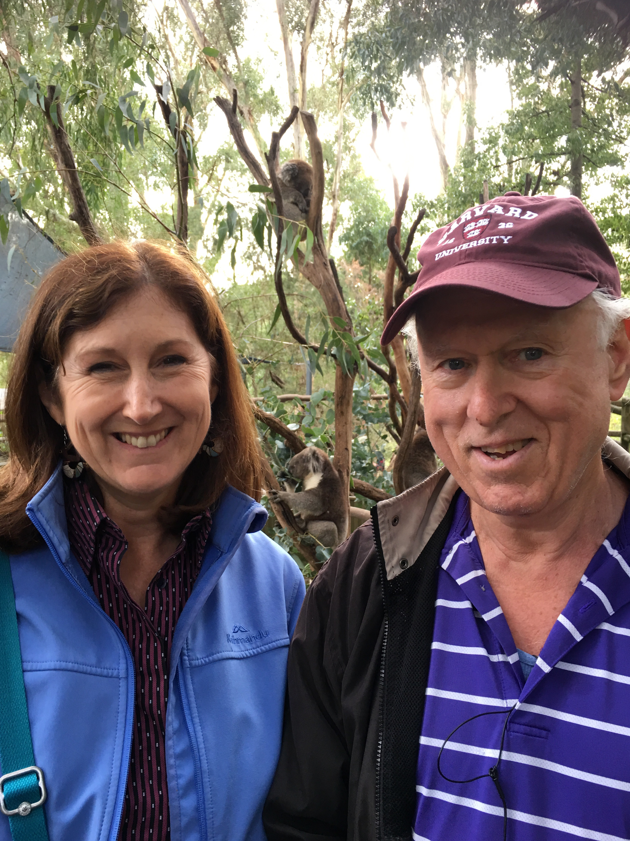
What are they?
“Grassroots associations are locally based, significantly autonomous, volunteer-run, formal non-profit groups that manifest substantial voluntary altruism as groups and use the associational form of organization and, thus, have official memberships of volunteers who perform most, and often all, of the work/activity done in and by these non-profits”.
(David Horton Smith, 2000, p.7)
Me and Professor David Horton Smith
Notes:
So, what are grassroots associations?
I use the definition penned by the leading researcher in this area, Emeritus Professor David Horton Smith, from Boston College, who has been cited over 2000 times in academic journals.
He defines grassroots associations as very small groups, locally based, altruistic in nature, who have a membership base, and are totally run by volunteers, having no paid staff.
Examples of grassroots associations include,
Soccer clubs,
Nature societies,
Local Red Crescent societies,
Resident associations,
Car clubs,
Local chapters of service clubs Lions,
Art and craft groups, and
Community bands - just to name a few.
This photo of Professor Smith was taken in Adelaide, where to my surprise he was a visiting professor a few months ago at Flinders University.
I was fortunate enough to introduce him to friendly a Koala during a short excursion outside the city.

Slide 6
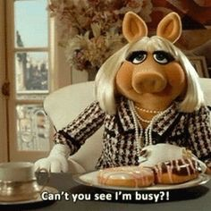
Leaders of grassroots associations are my focus
Notes:
The leaders of these grassroots associations, are the focus of my research – because without them, these vital associations could not exist.
And so, the research objectives of my study are, to
One, find out if membership numbers are in fact declining in grassroots associations, like volunteer participation is,
Two – to establish if there is a parallel decline of committee nominations for associations, and If so, what is the level of concern,
Three – to find out why regular members of associations are not stepping up to be on their committees, and,
Four – to uncover what interventions could be implemented that would convert members to become leaders of their associations.

Slide 7


Methodology
Online survey
Focus Groups
Notes:
My research project employed a mixed-methods methodology, which included focus groups and a survey.
The focus groups were held in mid 2016 in three different locations in South Australia, including a rural community, an outer suburban township and an inner-metropolitan suburb of Adelaide.
There were six focus groups in total, three with volunteer leaders of associations, and three with regular members. All focus group conversations were confidential, manually transcribed, and coded using NVivo software.
The survey was conducted in 2017, and it had 1500 respondents from both grassroots associations and larger not-for-profits.
Survey Monkey software was used to collect responses which were also anonymous. There were over 5000 written comments within the survey, and these were also coded with NVivo software.
The vast majority of respondents were South Australian, and were volunteer leaders of grassroots associations - although there was a healthy response rate from regular members as well.

Slide 8
What were they asked?
Motivations
Barriers
Success factors
Perceptions
Recruitment strategies
Notes:
In both the focus groups and the survey, committee members had a slightly different questioning route than regular members of associations.
Largely they were asked,
What they enjoyed about being on a committee and what motivated them to join,
the current health of their committee,
what others perceived about committee volunteering,
why people did not want to join committees,
what were the key attributes that make a good committee, and,
suggested recruitment strategies, or changes to the way they operated, that could encourage regular members to become leaders of their associations.

Slide 9
Focus group findings
Reasons for joining committees
“I get a buzz out of it”.
“You can see how things could be better, so that’s how you get involved”.
“You get a lot of personal growth, don’t you”.
“Hopefully it might help me find a job”
“I love motivating people”
Notes:
First to the focus group findings.
As this slide shows, according to participants, the main reasons for joining committees was for
Enjoyment,
Self-satisfaction,
Influencing the outcomes of their association,
The ability to use their skills, and to
Help their career.
Obviously, more committee members than regular members had something to say about this question, hence the larger numbers of contributions from committee members.
.

Slide 10
Focus group findings
Barriers to joining committees
“A lot of it is about power and the people who hold positions can make life absolute hell”.
“Yes, that’s a common theme, ‘can’t do it, I haven’t got the time”.
“They like the social activities, but don’t want to get involved
”I’m not really sure if I’m good enough to be on the committee”.
“I feel that enough is enough”.
Notes:
Participants reported many barriers to joining committees, and the main ones were,
Group politics and bad behaviours such as bullying,
Not having enough free time due to work or family commitments,
Having to deal with red tape, which includes tedious grant applications, insurance requirements, and criminal history checks.
Some experienced feelings of alienation, or not feeling ‘good enough’ to be on a committee,
Others saw no reason to be on a committee, and researchers call these people Pay ‘n’ Players or Free Riders, who join associations for benefits such as the rights to use a tennis court, learning to knit, or playing in a community band.
Burnout was reported by some previous leaders, who spent time on committees with little reward, or were just tired of serving as leaders.

Slide 11
Focus group findings
Factors for committee success
“It’s important that the committee is approachable and willing to listen”
“You’ve go t to make sure that you treat people how you would like yourself to be treated”
“Take on what members are saying”
Notes:
On the flip side, focus group participants were asked what made committees work well.
Good communication, letting people know what is going on, was the leading success factor for well-functioning committees, with more regular members suggesting this than leaders.
Quality leadership was mentioned by many, which is about selling the vision of an association, achieving outcomes and treating people well.
Recognition of others was mentioned by more regular members than leaders, and this was about communicating a job well done or giving a simple thank-you.
Changing with the times was an interesting attribute that was mentioned, and this included welcoming new technology or changing the operations of an association, such as meeting times or out-dated procedures.
Sharing the load. Like the old saying, many hands make light work, more regular members than leaders suggested that that a good committee makes sure that workloads are evenly shared amongst members.

Slide 12
Focus group findings
Reasons for committee difficulties
“There are problems with committees who have closed shops”.
”The committee is exhausted because we’re just recycling those who are in it.”
“People don’t want to join things”.
“We’re all getting older, who’s going to take over from us?”.
“By the time you’ve done the health hazards, food handling risk assessments etc – you’re snowed under with the red tape”.
Notes:
Focus group participants also offered reasons why committees didn’t work so well
Committee members had more to say about this issue than regular members, due to their day-to-day experience being leaders.
Many spoke of oligarchy behaviours, where the same people appear to serve on committees year after year, and suffer from what is called ‘group think’. These committees can appear unwilling to change or reluctant to give up their positions.
However, appearances can be deceiving. Some committee members complained that they only stay on committees because they can’t get any new blood, so oligarchies can be a vicious cycle.
Several people spoke about a general decline in association membership, which reduced the pool of potential leaders.
The gradual encroachment of red tape was mentioned, especially by leaders who had to deal with it. An increasing litigious society in Australia has led to mandatory policy checks, food handing regulations, risk management plans, and first aid training.
Not surprisingly, many talked about how they couldn’t fill committee positions, which is what this study is all about.

Slide 13
Focus group findings
Successful recruitment strategies
“Every single one that I’ve been involved in, I’ve actually been asked by someone I couldn’t say no to”.
“Clarify the roles, make it clear that committee members don’t do all the work”.
“If you don’t have a good size membership, you’re not going to get the committee people you need”.
“You get someone new and say, ‘just watch’, or ‘come to a meeting and see what I do’ – give them a little job”.
Notes:
Participants were asked what strategies would encourage more people to nominate for leadership positions.
The old ‘Tap on the shoulder’ was the most popular response, as most were recruited in that way, and that people were complemented when asked.
Many regular members suggested that if people knew exactly what was involved, more would nominate for leadership positions so that they could judge if they could contribute, enjoy the work, and fit it in their schedules.
Advertising was mentioned, especially in social media.
Mentoring was suggested, more by regular members, as a way of encouraging people who may not have confidence or want to learn the ropes gradually.
Being able to offer flexibility & episodic opportunities was suggested, to get around the ‘lack of time’ barrier, and,
Some thought that better promotion of the vision or cause of association would be beneficial.

Slide 14
Summary of focus group findings
Committee politics and bad behaviours outranked lack of time as the leading barrier to joining committees.
Following the old ‘tap on the shoulder’, the most popular recruitment strategies were changes to committee cultural and operations.
Some elderly leaders have to quit not because they want to, but because of mental and physical decline.
Notes:
To re-cap on the focus group findings,
Whilst lack of time was an important barrier, committee politics and bad behavours were the leading topics of conversation.
Following the old ‘tap on the shoulder’, changing the culture and the ways things were done were also important in order to attract leaders.
Problems of oligarchy were a consistent theme in the focus groups, with older committee members complaining about not being able to let go because of the lack of new blood coming in.

Slide 15

Survey findings
Who responded?
Notes:
Now to the survey findings.
Email invitations were sent to a list of 5000 associations in South Australia, through a public state-wide community information directory.
A little over 1500 people responded to the survey, which is a healthy 30 percent response rate.
I already touched on the demographics of the respondents, and there was also a great diversity of sectors included, with sport, the arts, community development and recreation all well represented.
Most respondents were frequent volunteers, serving or participating in their association at least once a week.
And most respondents volunteered with associations that were quite small, with less than 100 members.

Slide 16
Survey findings
Current state of grassroots associations
Notes:
The current state of grassroots associations in South Australia is quite disturbing.
66% of the respondents from grassroots association are having difficulty recruiting volunteers, compared to 54% of respondents from associations with paid staff.
61% are having difficulty finding new members, compared to 45% from larger non-profit associations.
67% of grassroots associations are have difficulty recruiting leaders, vs 49% of associations with paid staff, and,
78% of respondents from grassroots associations report little turnover in leadership, compared to 66% of larger non-profits.

Slide 17
Survey findings
Why people lead grassroots associations
Notes:
So why do people join committees in the first place?
The main reasons are, firstly, that they are concerned about the associations’ purpose or cause, and secondly, they have a strong desire to put their skills to good use.
Other significant reasons why they volunteer as leaders, are that they
get to influence outcomes,
it’s becomes a key part of their social life,
they want to learn more about the cause or activity, through direct experience,
it gives them a sense of identity,
it’s a way to make new friends, and it
makes them feel needed.
Some people, primarily the younger respondents, said that being on a committee allowed them to explore career opportunities and gain management experience.

Slide 18
Survey findings
Barriers to leadership
Notes:
As you would suspect, survey respondents mentioned many barriers to joining committees, that were similar to those from focus group participants.
Not wanting the weight of responsibility on their shoulders was the top mentioned barrier, and this is where that issue of red tape sits.
Lack of time, due to work or family commitments, was also frequently mentioned.
Both leaders and regular members equally observed that many people were too afraid or shy to put themselves forward to lead, didn’t feel they had the right skills for committee work, or that some people simply don’t like going to meetings.
Many more regular members that leaders felt that oligarchies were a problem, and that the same people are on committees year after year, and were not open to change, or didn’t like committee politics or personality conflicts.
Interestingly, more leaders than regular members were worried about legal liabilities, and perhaps felt that there were no benefits to be gained by being on a committee.
Let me share with you some interesting comments shared by survey respondents.
This one is about the time barrier: “Small rural communities are in volunteer overload - it's a constant struggle of juggling business, kids, school buses and volunteer rosters.”
And about red tape, “I have been on the committee for 13 years and it is now an all year-round job to comply with Government regulations. The government seems to have forgotten that we are all unpaid volunteers and that we first need to hold down a career, family and then volunteer.”
There were some interesting comments about committee politics, with one person saying, “There are some nasty individuals who make it unpleasant for others”, and another pointing out that, “some are there for their own ego trip rather than for the good of the club and committee”
Apathy came up a lot, with comments such as, “People just want to stay at home and surf the net or watch TV. Rampant apathy, lazy no motivation”, … ”People are too preoccupied and self-centred with their own world to give back to community.”, and ,“There’s not the same sense of community commitment as has existed in the past.”
Some blamed young people, with comments such as “I find the younger generation is all about ‘me’ first and that the community ‘stuff’ comes a poor last.”
And finally, many complained of free-riders, with comments such as, “Most members want what they can get from the Club without any responsibility.”

Slide 19
Survey findings
Attributes of successful committees
Notes:
Survey respondents were also asked what makes good committees work, and the answers were largely the flip side of barriers
Having a positive attitudes and enthusiasm was ranked highest, followed by recognition and respect of fellow members and volunteers.
Good communication was also highly ranked, which was about sharing information with members and fellow leaders on a regular basis.
Effective leadership was seen as very important, and this was largely about effective strategic planning, good delegation and positive relationships.
Other important attributes of successful committees included high visibility and brand recognition for the association, and committee members having appropriate skills to lead.

Slide 20
Survey findings
Recruitments strategies for new leaders
Notes:
There were quite a few leader recruitment strategies suggested by survey respondents.
This slide shows responses from only regular members & the strongly agree answers.
Mentoring was top, which was about letting people ease into the job, being supported by existing committee members.
Having role descriptions and being clear about what’s involved,
having a healthy and inclusive committee culture,
inviting prospective leaders to events and functions to get a flavor of what the association is all about,
communicating the benefits of serving on a committee,
delegating tasks broadly to share the work load,
advertise through social media, which was ranked high by the under 50s, and,
being flexible about tasks and meeting times.

Slide 21
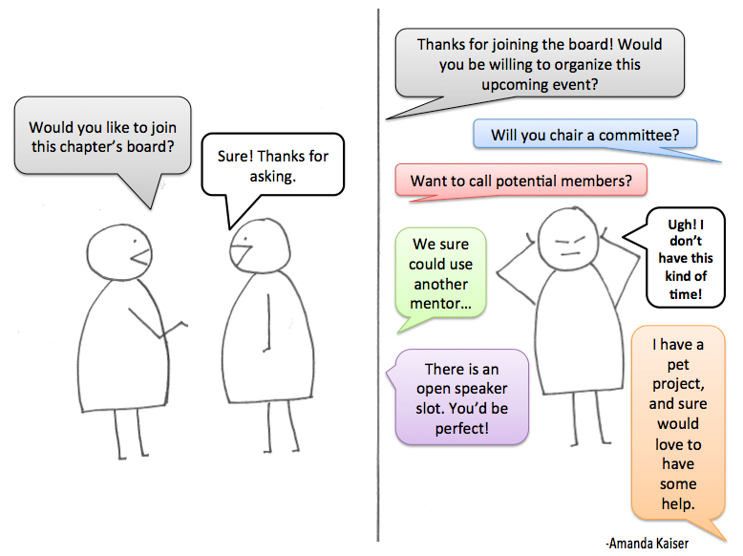
Survey findings
Notes:
In summary, the survey results
confirmed and expanded on the focus group findings,
demonstrated that it’s not easy to lead an association,
highlighted generational differences in perceptions and attitudes,
showed that red tape is a huge barrier, and makes it difficult for committees to change their culture, and,
highlighted that there is both resistance to change by some committees, and a willingness to change by others.
(PAUSE)
A big message to me, was that associations are crying out for support, and that Australia is experiencing social change on a massive scale which having a big impact on grassroots associations.
It is clear that they need support, but unfortunately, they are invisible to governments and the volunteering infrastructure.

Slide 22
Conclusions
Macro societal changes are having huge effect on grassroots associations
Neo-liberalism and professionalism
New technology – Are Facebook groups the disruptive innovation in this space?
Chasm between governments, the volunteer infrastructure and grassroots associations
Notes:
The data from the focus groups, and survey, brought out massive social issues that are effecting grassroots associations
I believe that there is a tipping point on the horizon, which may see the closure of a vast number of grassroots associations because they can’t find leaders. From my perspective, the main issues are firstly,
Neo-liberalism, which may be causing people to become more individualist, and associations to become more professional, which is not what volunteers signed up for.
Secondly, new technology is changing the way associations communicate and operate – could Facebook groups be the disruptive innovation in this space? Will we be seeing more online connection, and less face-to-face interaction?
And thirdly, there is a growing chasm between governments, the volunteer infrastructure and grassroots associations.
Funding and support is not reaching small groups because they don’t qualify for volunteer infrastructure membership or meet complex government funding criteria.

Slide 23
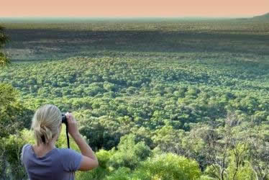
Further research opportunities
What can the volunteering infrastructure and governments do to support volunteer leaders?
Do online groups provide the same social benefits as traditional face-to-face grassroots associations? Or are hybrids the best model?
If we do nothing, how will the continued decline of GAs impact society?
Notes:
This research clearly demonstrates that there is a lack of support for the leaders of grassroots associations, and there is a big opportuning for the volunteering infrastructure and governments to support these associations and their volunteer leaders.
The study also raises the impact of new technology and how it is effecting grassroots associations. Do online Facebook groups provide the same social benefits as traditional face-to-face associations? After all, community bands actually do need to meet face-to-face to rehears and perform.
Or are hybrids the best model, where social media actual supports face-to-face contact instead of displacing it?
And finally, if we do nothing, how will the continued decline of grassroots associations impact society?

Slide 24
References
ABS General Social Survey: Summary Results 2014
Brudney, JL & Meijs, L 2013, 'Our Common Commons: Policies for Sustaining Volunteer Energy', Nonprofit Policy Forum, vol. 4, no.1, p. 29.
Contribution of the Not-for-Profit Sector, Australian Government Productivity Commission, 2010.
Haski - Leventhal, D, Meijs, LC & Hustinx, L 2010, 'The third party model: enhancing volunteering through governments, corporations and educational institutes', Journal of Social Policy, vol. 39, no.1, pp. 139-58.
Holmes, K & Slater, A 2012, ‘Patterns of voluntary participation in membership associations: A study of UK Heritage supporter groups’, Nonprofit and Voluntary Sector Quarterly, vol. 41, no. 5, pp. 850-869.
Smith, DH 2000, Grassroots Associations, Sage, Thousand Oaks, CA.
Harrison Research, Volunteering in South Australia, 2016, Office for Volunteers, South Australia.
Notes:
If anyone would like to follow up this research, I will be happy to provide my slides which includes these references.

Slide 25

Thank you
Questions/Discussion
Dr Christel L. Mex
Research Associate
Flinders University
mex0001@flinders.edu.au
LP140100528
Notes:
Thank you so much for listening today, and I look forward to your questions during the panel session.
I would like to thank my Supervisor, Professor Melanie Oppenheimer, and the Australian Research Council for their support in this study.
And here are my contact details if anyone would like further information.

