Slide 1
Which Tree, where? ….and how?
Adelaide’s climate – future climate projections
Choosing the right tree for the job means choosing the right tree for the future
Establishing the right tree – give it the best start in life!
Maintaining that tree to enhance productivity (feed me!)
Climate change and heat islands
Doing more with less (water)
Water in the environment – cooling (shade) and evapotranspiration

Slide 2
Future Adelaide Climate - constraints
In a nut shell….
Green cover is really important - your front and back yards
More heat with longer summers
Less annual rainfall
More energy in the weather – peak events
Notes:
Climate science and knowledge – SA Government https://www.environment.sa.gov.au/topics/climate-change/climate-science-knowledge-resources
Use of potable and non-potable water
Water in the environment

Slide 3
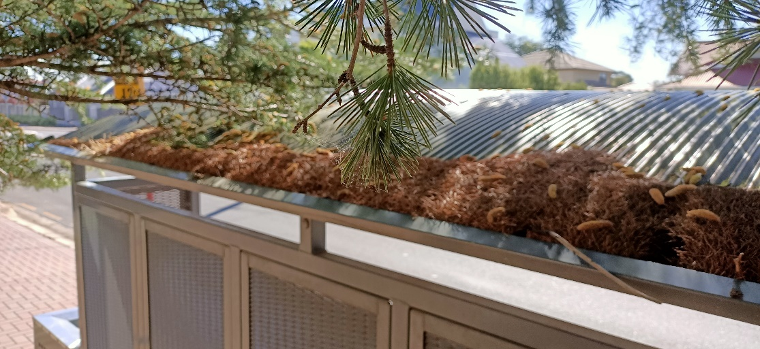
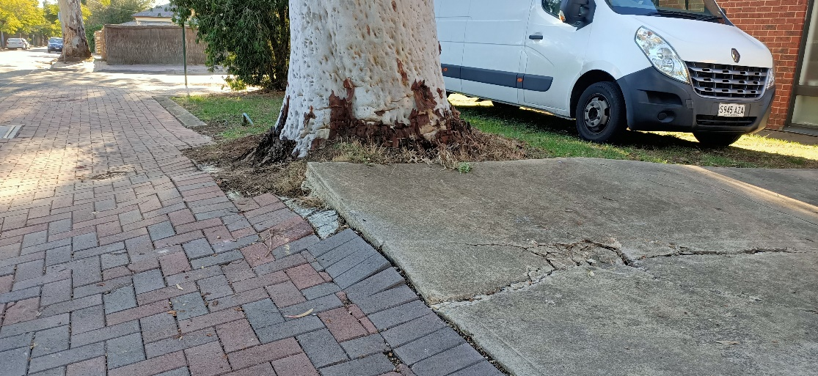
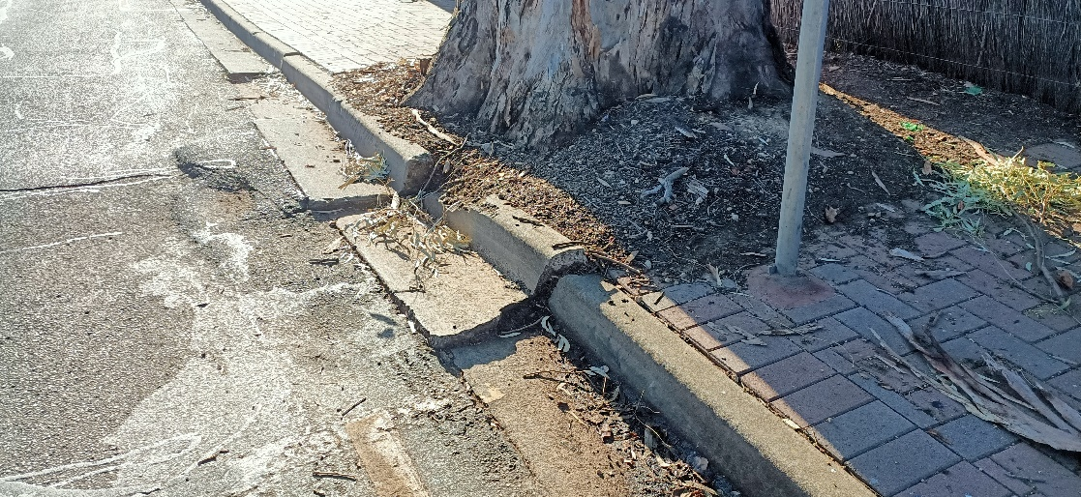
So…How to live with trees?
Trees are a nuisance….
Trees crack my house!
Trees buckle the paving / footpath
Trees drop leaves, block gutters
Trees will kill my children!

Slide 4
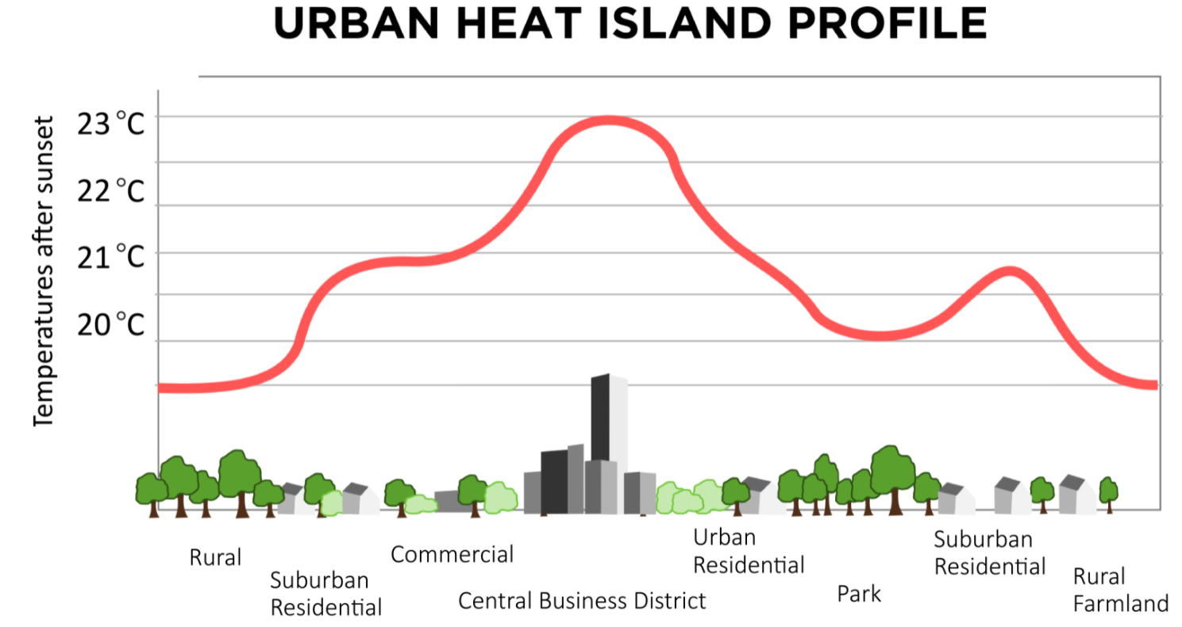
Notes:
But they are vital

Slide 5
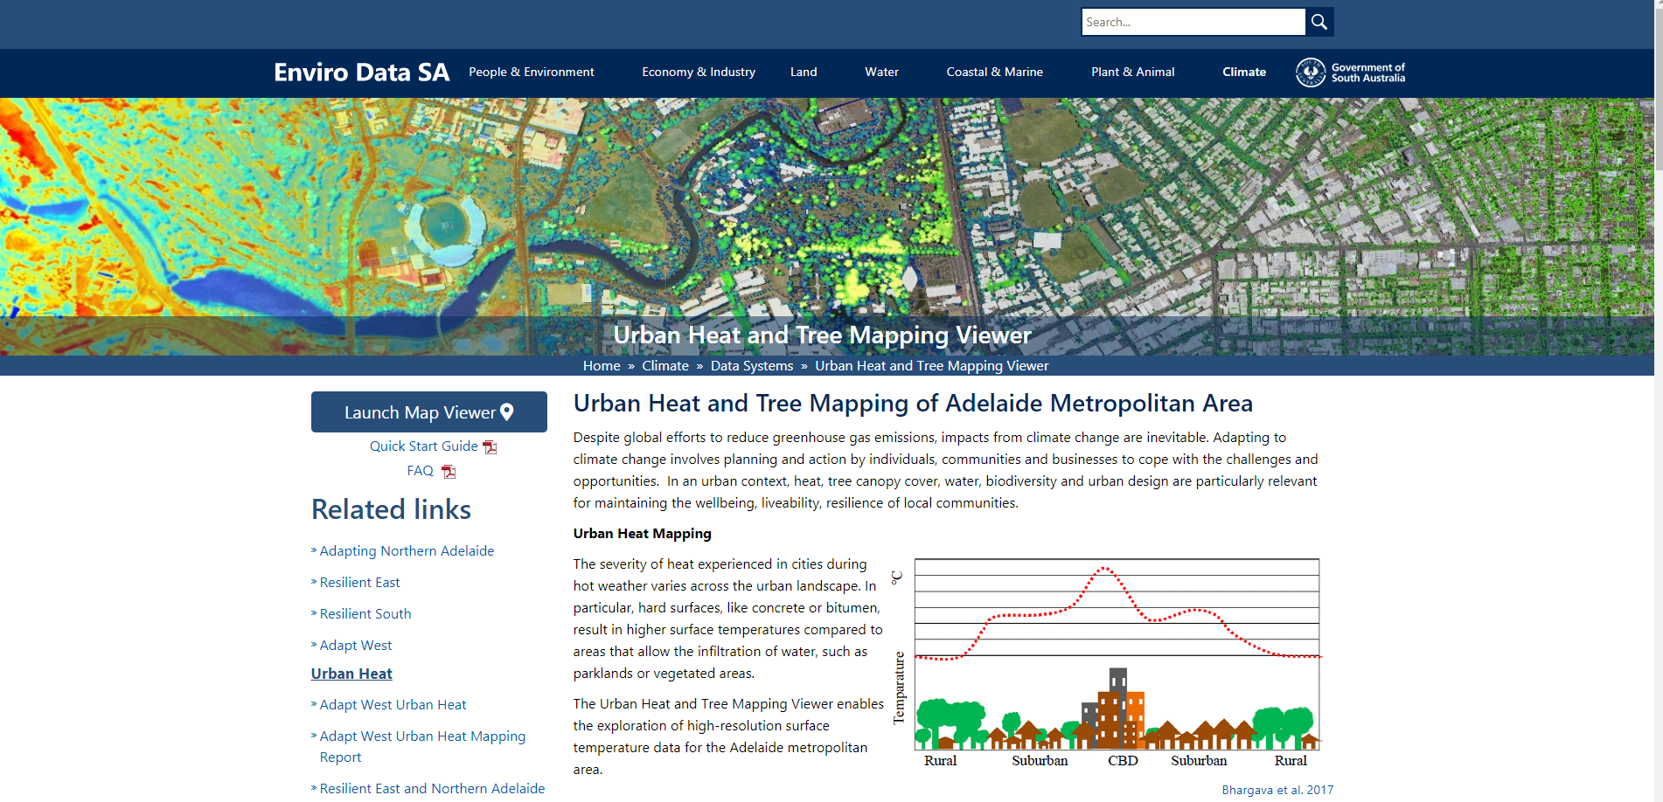
https://data.environment.sa.gov.au/Climate/Data-Systems/Urban-Heat-Mapping/Pages/default.aspx
Notes:
Explore the heat maps

Slide 6
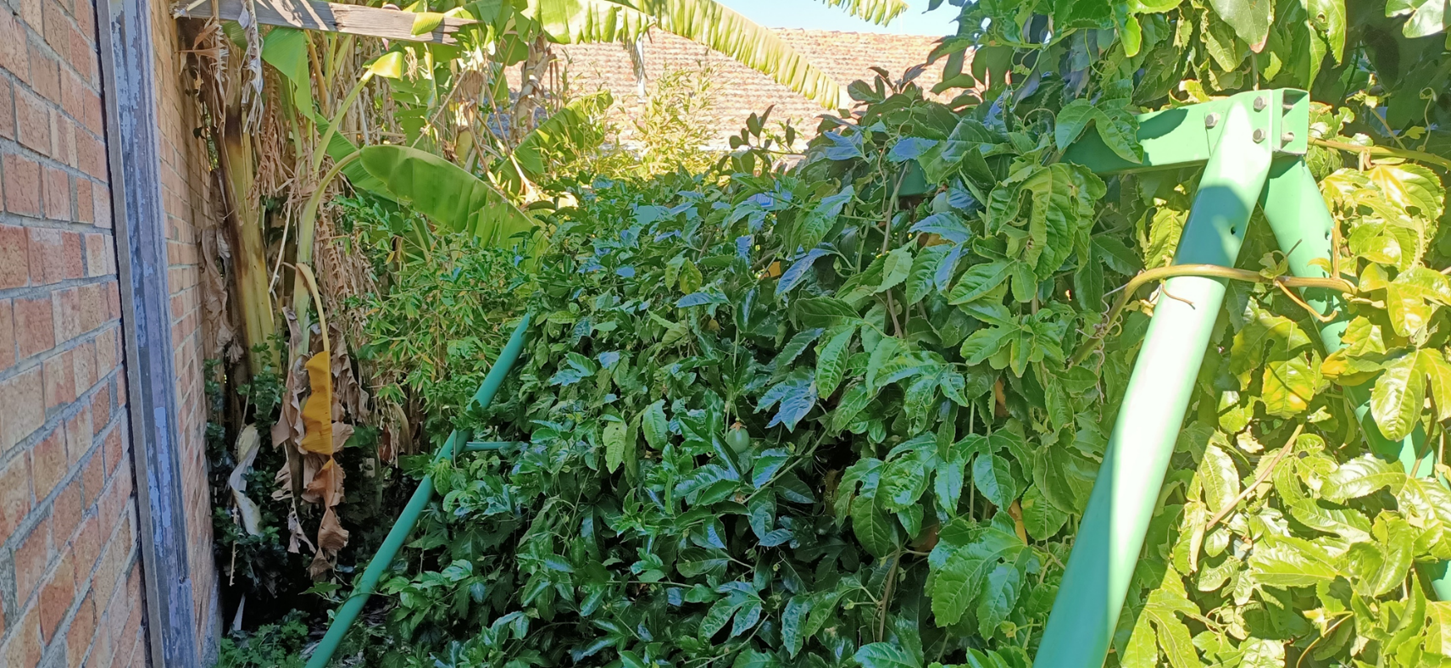
It’s all about the micro climate..
That is a combination of factors…
Soil
Wind
Warmth
Shade
Wind breaks
Other plants
Using to our advantage…

Slide 7
How do I plan around trees
New homes and extensions
Tree protection zones during construction
Working with a designer
Not working with a “clean slate”
Footings and engineering
Permeable paving / WSUD

Slide 8
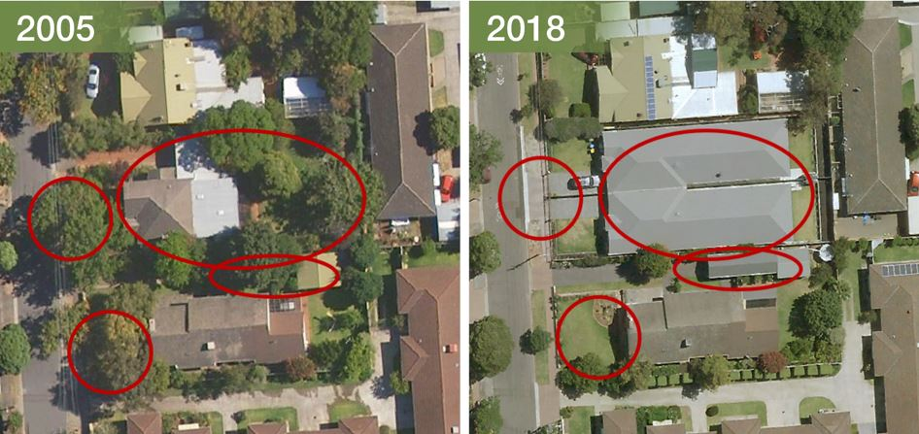
Urban development

Slide 9
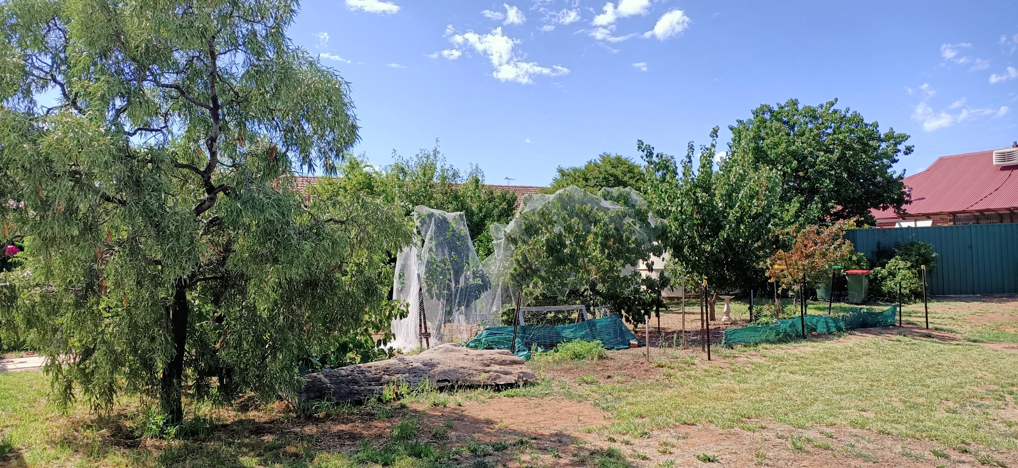
Variety of trees grown closely together

Slide 10
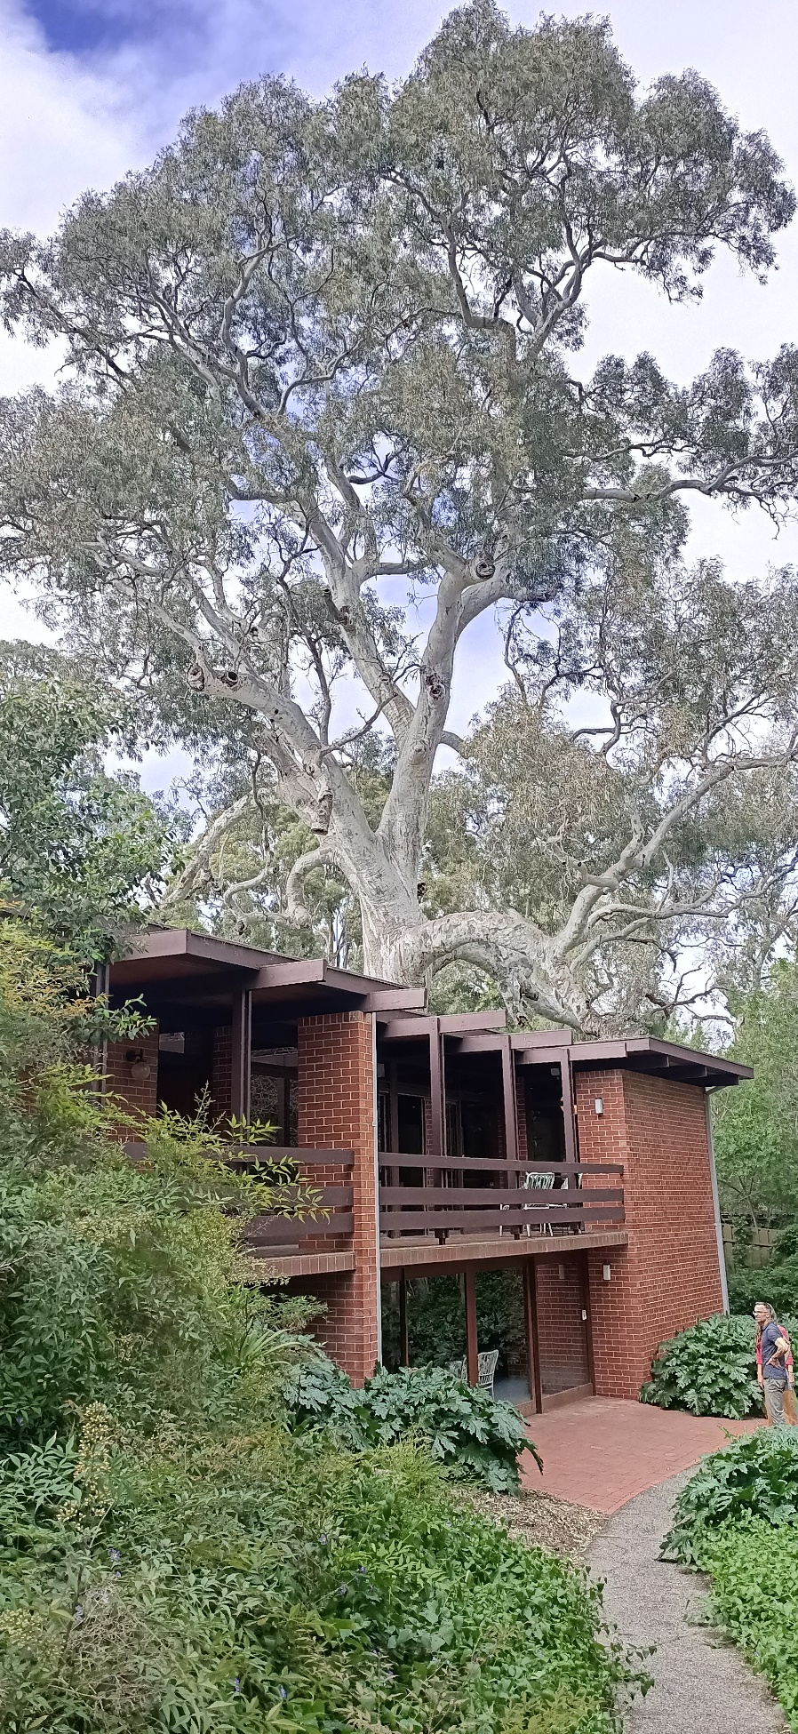
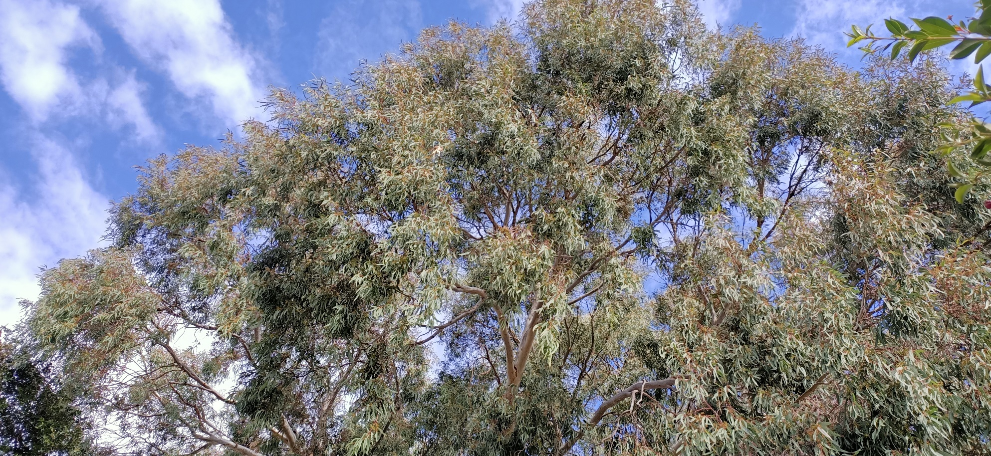
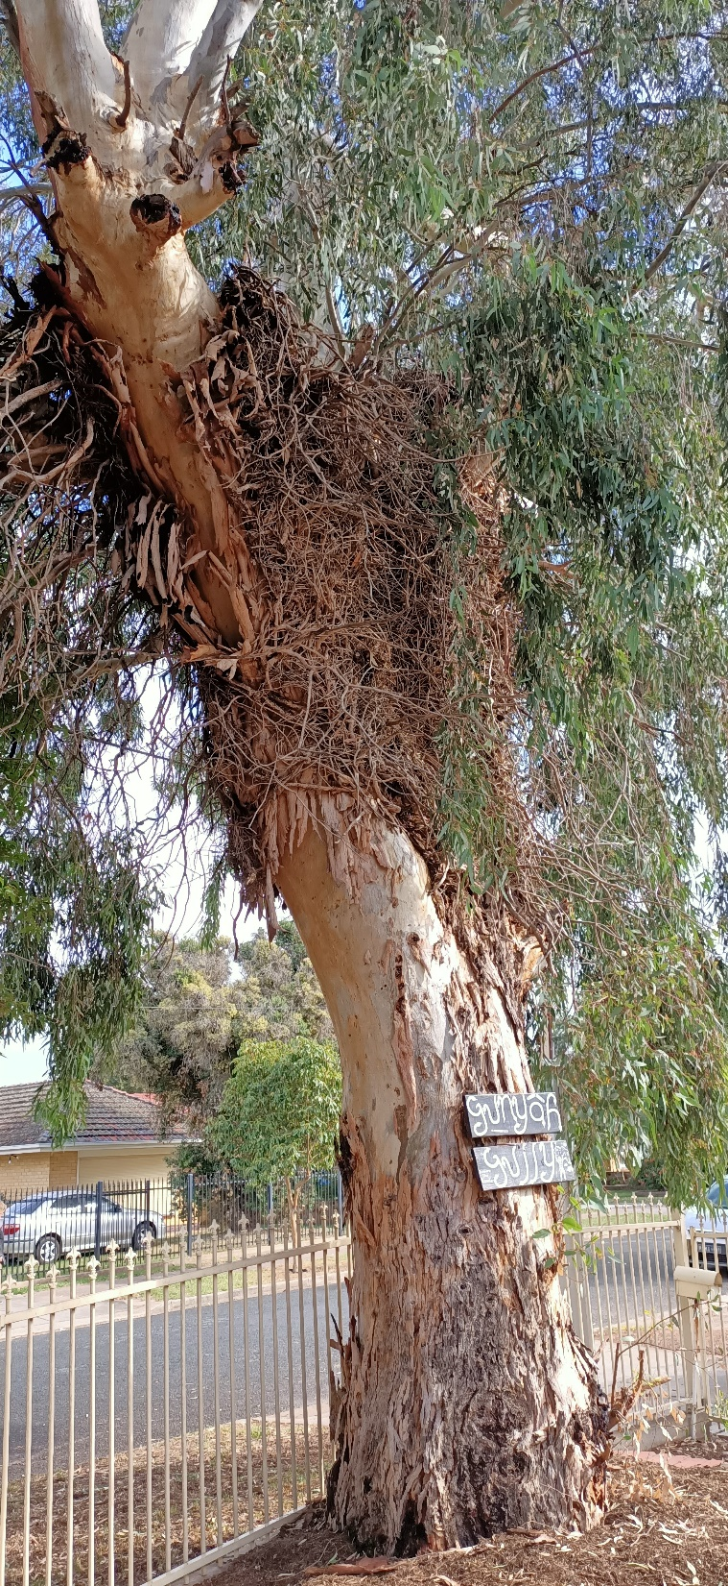
Notes:
And older established trees – like ecocities
Getting to know a tree

Slide 11
Selection - things to consider…
Site aspect & micro climate
Soil quality – making it a sponge – a long term project
The size and spread of the tree = your capacity to prune and maintain
Is cleaning gutters an issue? – second storey issues (gutter design and modification)
Composting of leaf litter, putting it in green bin or letting it accumulate around trees (the case for the “messy” garden)

Slide 12
But, what is the right tree for you?
We already live in a modified landscape…
  Native trees are great…
  Exotic trees are great…
  Food producing trees are great…
  Most councils don’t want fruit trees as street trees (liability)
  Smaller blocks and deep root zones – in ground or in pots?

Slide 13
Establishment
Digging the right hole – how wide, how deep
Getting the soil right – what is the best soil?
Planting at the right time – when should you plant a tree?
Getting that tree established – watering and pruning to get the best start in life
Notes:
Hole 1 metre around the pot / base of tree
Roots getting into soil – give it a chance
Prune canopy down by 1/3 to focus energy into roots
Any tree moving from pot to soil is going to be shocked – reduce size straight away
Cycle of the tree – roots take up nutrients from deep in the soil to the leaves – the leaves drop to the ground – insects / soil microbes break down leaves freeing up nutrients for tree
Deciduous trees in cool months- they are dormant – plant and reduce canopy
Non-deciduous trees spring when the soil is warm
Focus on the tree putting down strong roots

Slide 14
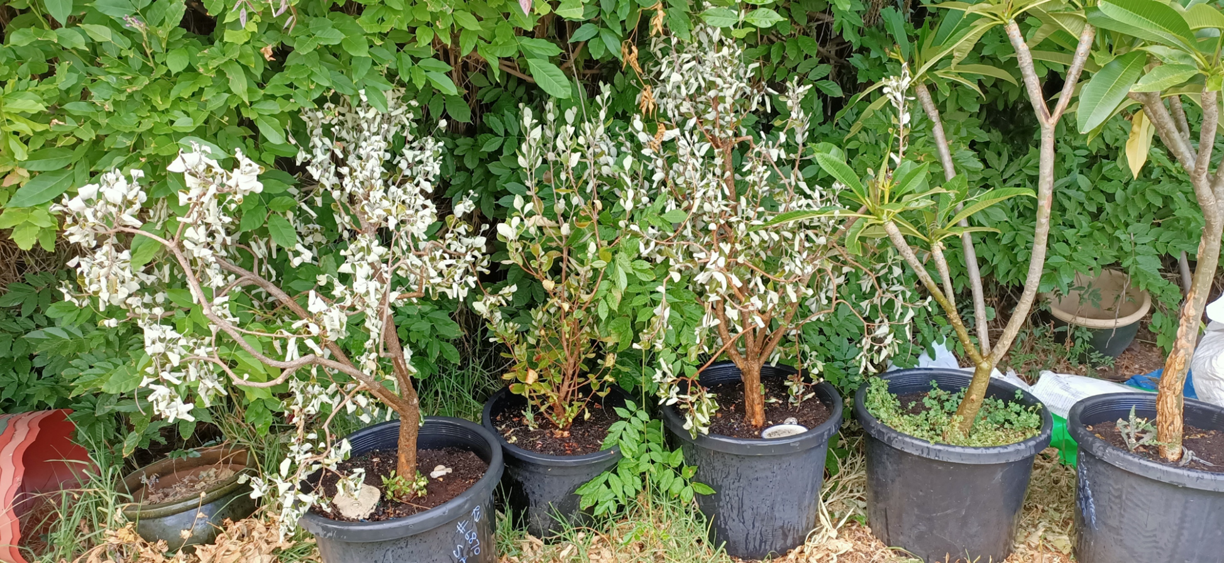
Maintenance
Stress / heat
Maintaining a canopy
Water and mulch
…what not to do

Slide 15
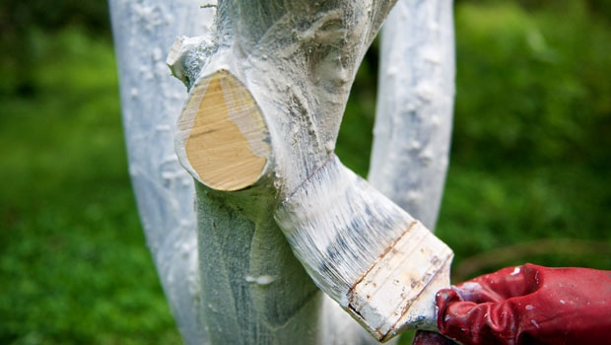

Lime based white wash
https://www.youtube.com/watch?v=lFbloOu_raQ
Notes:
Or the cheapest white acrylic paint you can find
Shade cloth – limit green –cuts out too much of the light spectrum
White shade cloth – 50% shade no more

Slide 16
Some resources…
Notes:
Lots in Adelaide / SA

Slide 17
Which plant where?
2030 / 2050 / 2070 – future trees
Some take home messages:
Talk to your local nursery
Look at climate matching for future conditions – what trees are grown successfully in similar climates
Ideally trees that are low water / heat tolerant

Slide 18
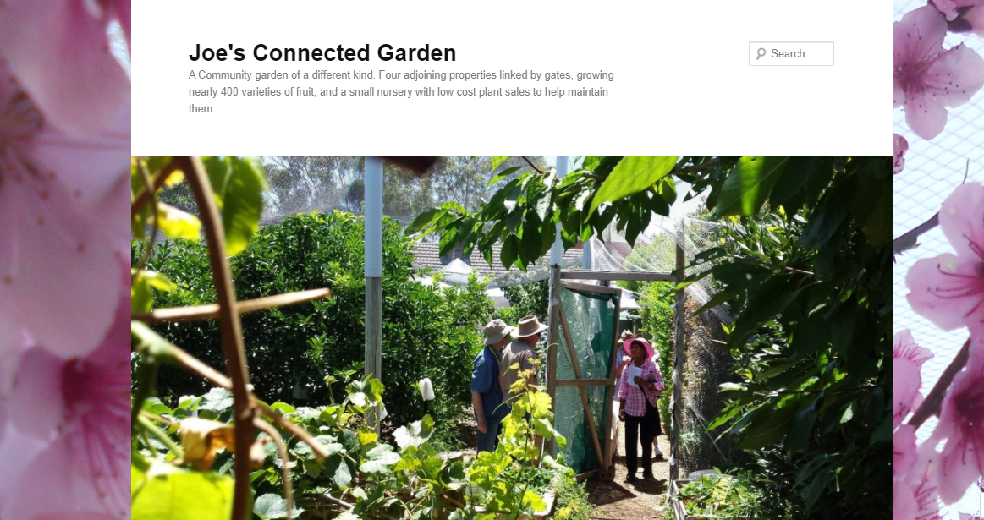
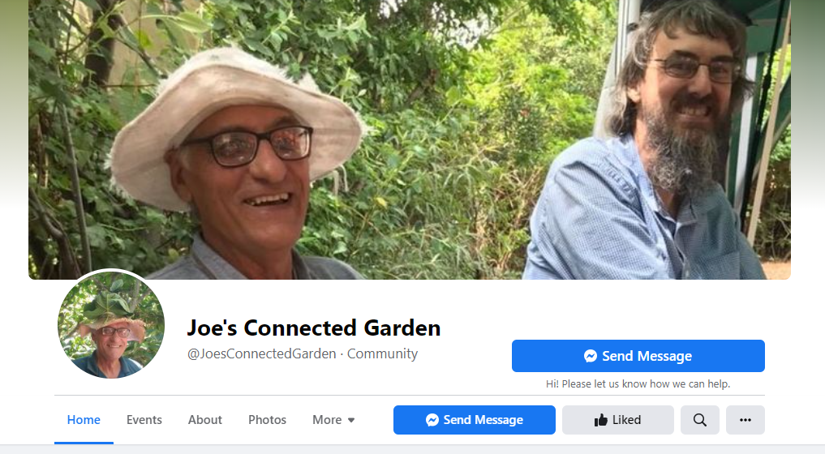
Open days
Workshops
Inspiration!
https://joesconnectedgarden.wordpress.com/
https://www.facebook.com/JoesConnectedGarden/

