Slide 1
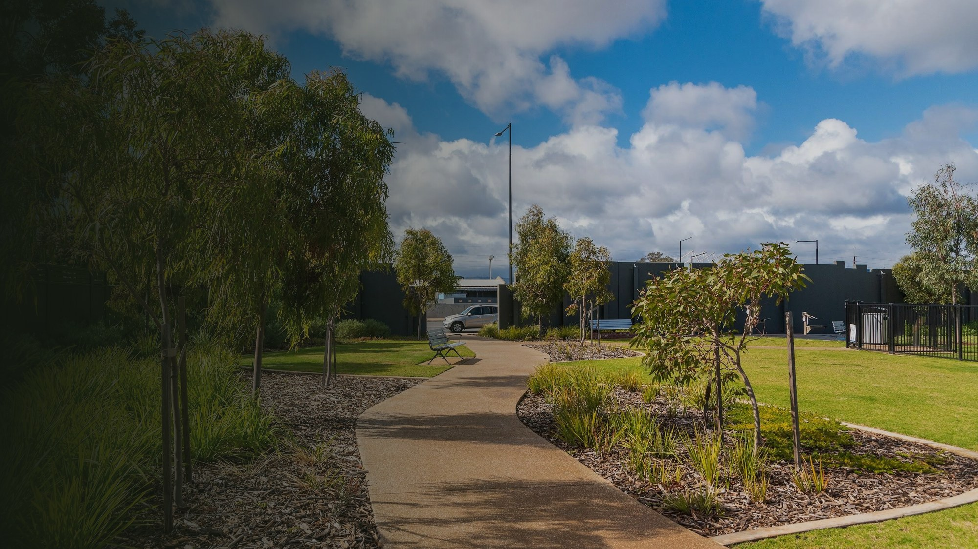

Sustainable
Communities SA
Memberships
June 2026

Slide 2


What SCSA Offers Your Project
Promotion
Co-hosting your events on Facebook.
Sharing your stories, posts and events across Facebook and Instagram.
A bio and links to your project website and socials on the SCSA website.
Quarterly newsletters celebrating SCSA project achievements.
Volunteer positions advertised via the SCSA LinkedIn page.
Support
Help setting up and hosting your own project website.
An SCSA-affiliated project email account (e.g. yourproject@sustainablecommunitiessa.org.au).
Free Google Workspace access — extended Drive storage and longer Google Meet calls (up to 24 hours, against the 60-minute cap on free accounts).

Slide 3



What SCSA Offers Your Project
Insurance
Public Liability Insurance — protects members of the public, important for public events.
Volunteer Insurance — protects the volunteers themselves.
Cover is provided through our partnership with Green Adelaide.
Financial
As an incorporated entity, SCSA can:
  Hold your project funds in our bank account.
  Pay invoices or reimburse project costs directly from your funds.
  Help you apply for grants — many require groups to be incorporated and insured, which you gain as an auspiced SCSA project.

Slide 4





Who to Contact at SCSA
info@
chair@
membership@
treasurer@
comms@
Secretary
Chair
Memberships
Treasurer
Comms
General enquiries — your first point of contact.
Grant & auspicing support (letters of currency, insurance).
Governance matters.
Membership payments.
Project volunteer lists.
Chargebee queries.
Withdrawal requests.
Project financial statements.
AGM ticketing.
Newsletter.
Website & social media.
All addresses end in @sustainablecommunitiessa.org.au

Slide 5




Membership Changes
Cost
Membership is now $15 — the first increase since SCSA was established in 2008.
Categories
The ‘Household’ membership option has been removed.
All volunteers now hold an individual SCSA membership.
Renewal
All memberships are aligning to a single renewal date of 1 July.
Every current membership — including any that lapsed recently — is extended at no cost to expire 1 July 2027, with nothing to pay in the interim.
From the 1 July 2027 renewal, membership is $15 for everyone. Reminders go out at least a month before.
Project Lists
We’ll request updated volunteer lists for each project about a month before the aligned renewal, so insurance cover stays current.

Slide 6


Paying Your Membership
What’s changed
Groups now choose to either pay for all of their volunteers, or have each volunteer pay individually.
In-person renewals are no longer accepted.
Paying on behalf of a group
Paying as an individual
EFT to SCSA (bank details on the website). We assign each project a reference code — quote it so we allocate your payment correctly.
Or a direct transfer from project funds already held by SCSA.
Note: coordinators paying for their group cannot use the Chargebee portal.
Auto-renewal via Chargebee (link on the website) using credit/debit card or PayPal.
Note: the Chargebee portal is for individual memberships only.
More info: sustainablecommunitiessa.org.au/join

Slide 7




2026 / 2027 Membership Timeline
May 2026
1 Jul 2026 – 1 Jul 2027
May 2027
Jun 2027
1 Jul 2027
2026 AGM
Aligned membership year
Volunteer lists
Renewal reminder
Aligned renewal due
Membership changes announced. Project volunteer lists requested at the start of May.
All current memberships extended at no cost to expire 1 July 2027. Nothing to pay in the interim.
Coordinators emailed for current project lists, so everyone stays covered under insurance.
Payment reminder about a month before the due date. Check your details in Chargebee.
Individuals auto-debited via Chargebee. Groups complete an EFT or transfer request form by this date.
Notes:
Chronological, dated from June 2026. The gift band (1 Jul 2026 – 1 Jul 2027) is the alignment itself: every current membership carried to the new 1 July anchor at no cost. Next charge for everyone is 1 July 2027.

